Slide 1
Regular Expressions
Nate Mahalingam

Slide 2
What are Regular Expressions?
In a nutshell…
Ways to match and extract patterns from text
Find all the legitimate phone numbers
Find all valid emails
Find only the numbers from text
Find the href link from a html tag
And many more…

Slide 3
Advantages
Fast!
Powerful
And most importantly…
Common across almost all languages

Slide 4
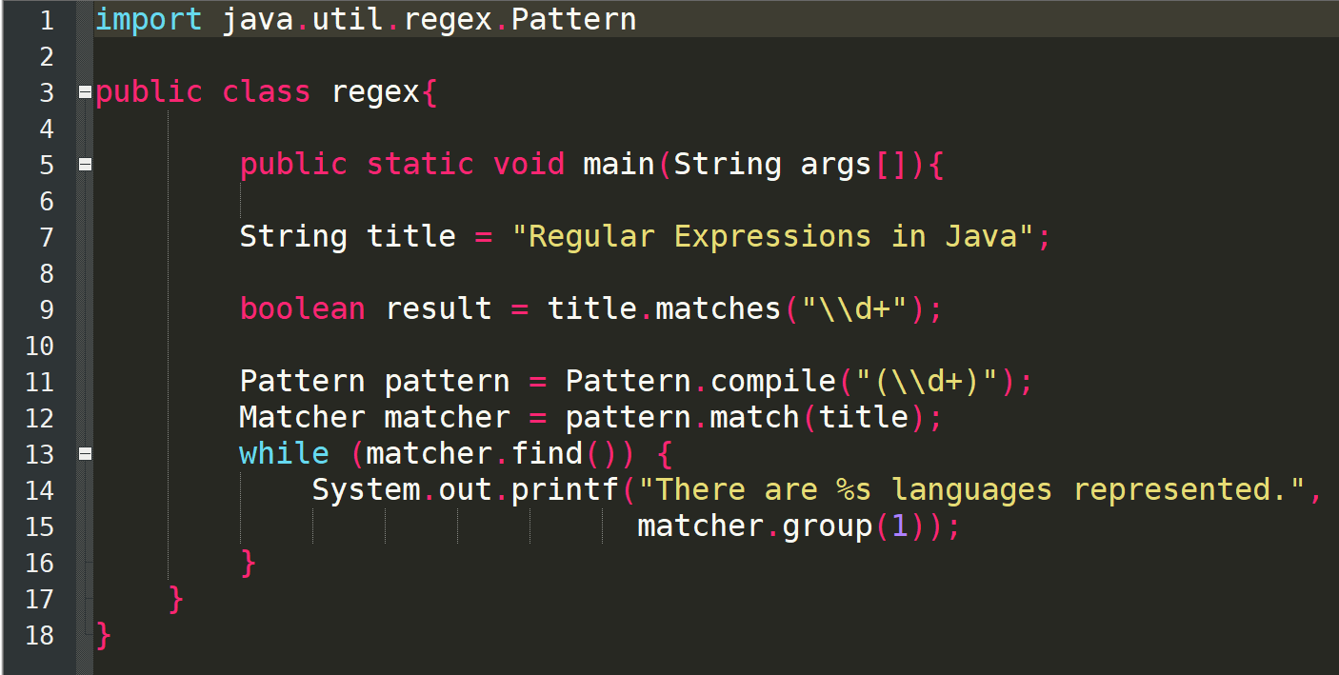
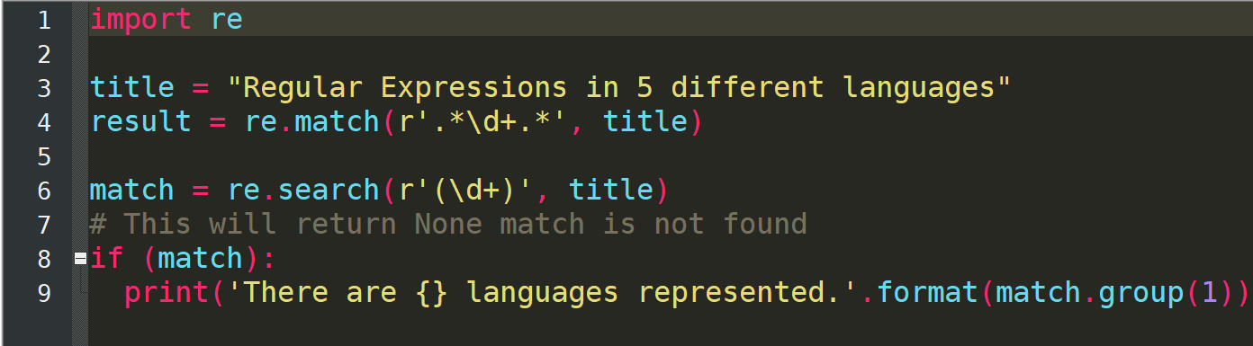
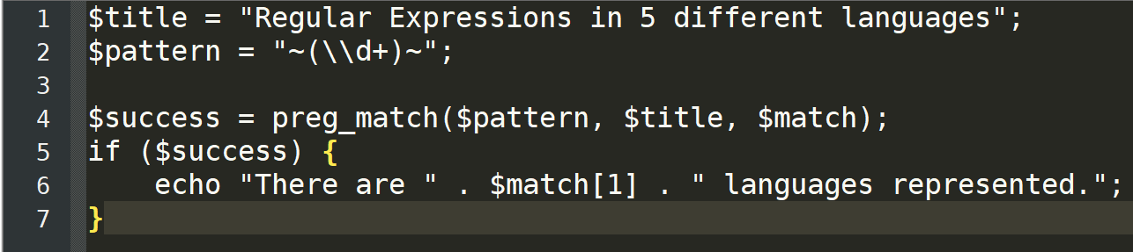
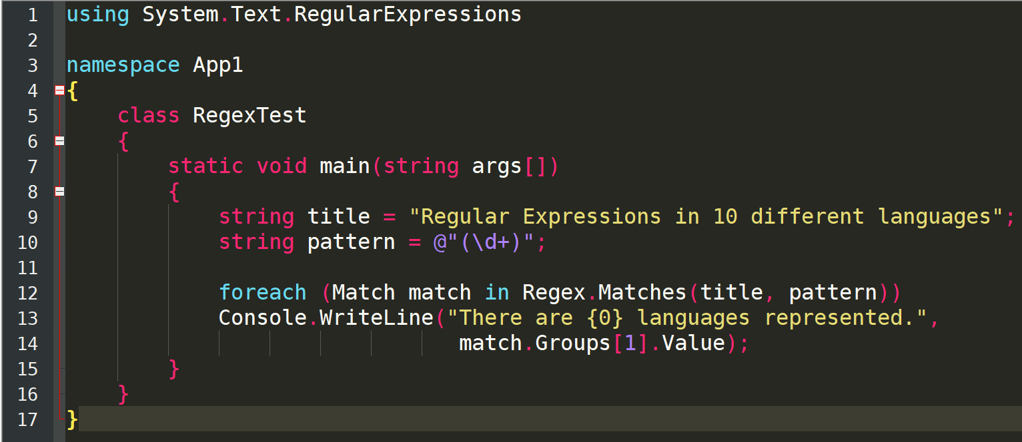
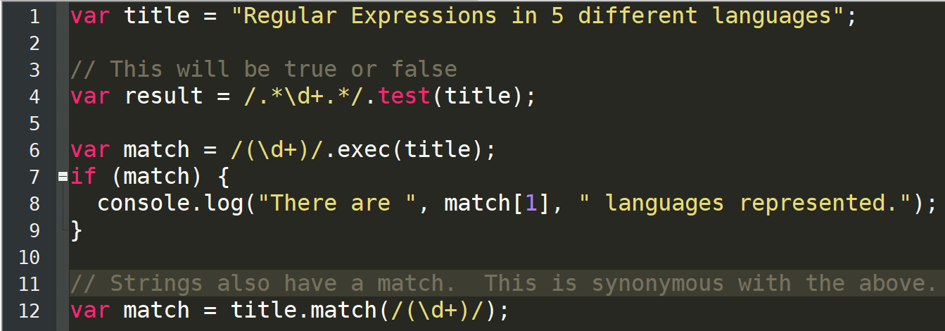
Java
Python
PHP
C#
Javascript

Slide 5
Regex in Python
The re module contains all the regex functions
Part of standard library – no need to install separately
To access re module, import it

Slide 6
To import an external package
Use the import keyword
Three ways to import
import <module>
from <module> import <sub-module>
import <long module name> as <short name>
Using the as keyword creates a substitute name for the module
Using the from keyword means that you don’t need to prefix imported functions with the package name

Slide 7
Using external functions
Example:
import xml.etree.ElementTree
tree = xml.etree.ElementTree.parse('country_data.xml')
root = tree.getroot()
Or
import xml.etree.ElementTree as ET
tree = ET.parse('country_data.xml')
root = tree.getroot()
Or
from xml.etree.ElementTree import *
tree = parse('country_data.xml')
root = tree.getroot()

Slide 8
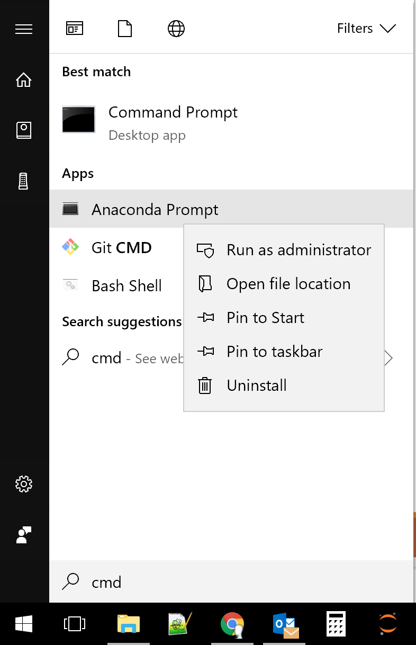
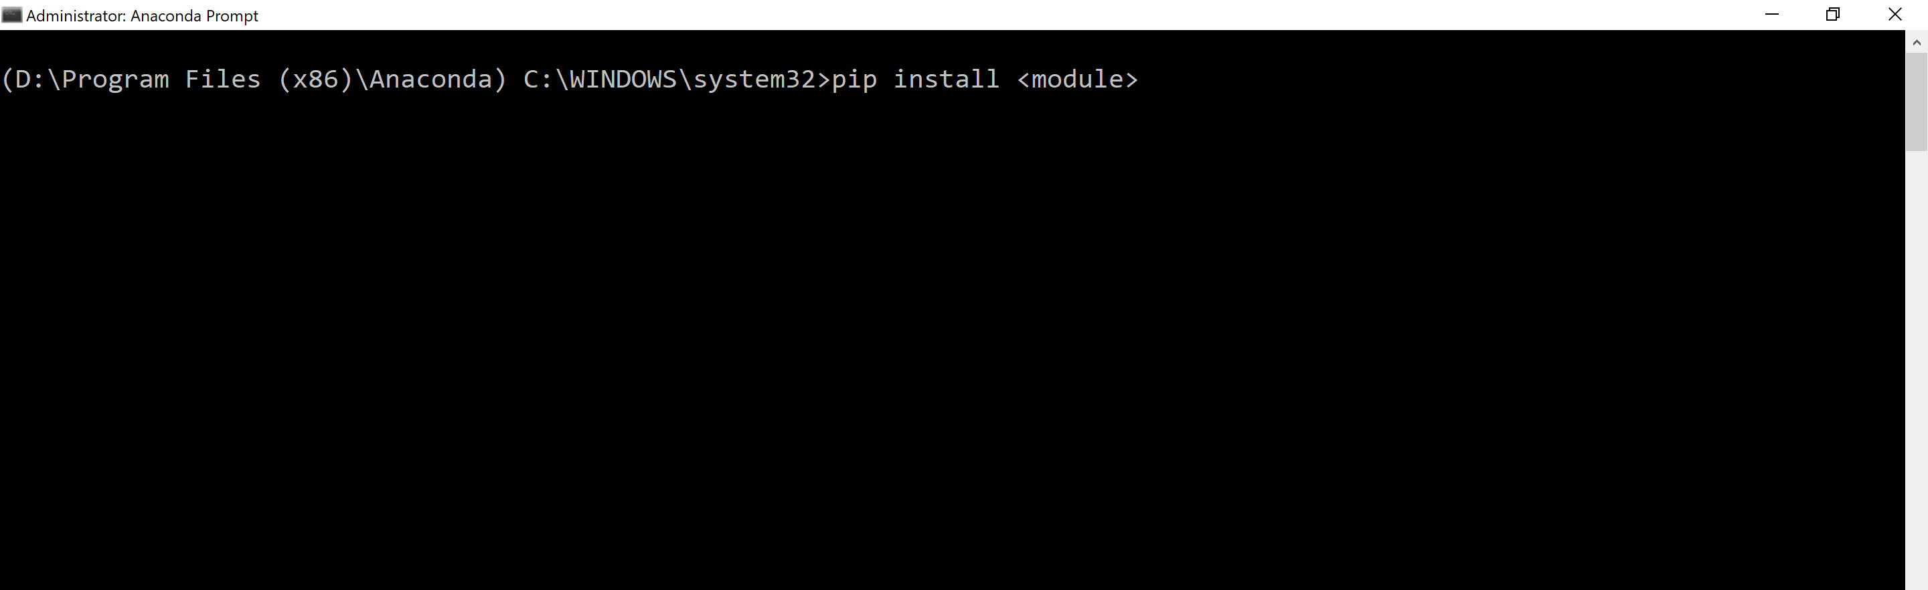
To install a package on Windows
Type cmd in Start and run Anaconda Prompt as administrator
Type pip install and then the package name in the shell
1
2

Slide 9
Installing on Mac
Open Terminal
Type sudo easy_install pip
Type password
pip install module
Notes:
sudo easy_install pip

Slide 10
Example regular expression
$$\text{^}\text{[\backslash }\text{w}\text{_+−\backslash .]\{1,20\}@[\backslash }\text{w}\text{\backslash }\text{.−]\{2,20\}}\text{\backslash }\text{.[}\text{A}\text{−}\text{Za}\text{−}\text{z}\text{]\{2,3\}\$}$$

Slide 11
